Slide 1
THREEFOLD SECURITY THROUGH HYBRID ENCRYPTION AND STEGANOGRAPHY KEY SAFEGUARDING
Team Details
M V S Sarvani(20eg105327)
P Shivani(20eg105341)
K Rakshitha(20eg105342)
Project Supervisor
Dr. T Shyam Prasad., M.Tech ., PhD
Assistant Professor
Department of Computer Science and Engineering

Slide 2
Introduction
In today's digital environment, the rising threat of malicious attacks necessitates robust information security measures. As services move to the Internet, the significance of protecting data has grown. Encryption algorithms have evolved to counter cryptanalysis, making it harder for attackers.Threefold Security employs hybrid encryption, combining symmetric and asymmetric methods for robust data protection. Steganography conceals cryptographic keys within seemingly innocuous data, enhancing security. This approach ensures a triple-layered defense, safeguarding sensitive information through advanced encryption and covert key storage. The combination of these techniques fortifies data integrity and confidentiality.
This approach finds applications in various domains such as secure communication, data protection, and confidentiality in sectors like finance, healthcare, and national security, offering a robust defense against cyber threats and unauthorized access to sensitive information.
Department of Computer Science and Engineering

Slide 3
Problem Statement
In the contemporary digital landscape, the escalating threat of malicious attacks underscores the need for robust information security. As online services proliferate, safeguarding data becomes increasingly crucial. While encryption has evolved to counter cryptanalysis, encrypted data remains a target. Threefold Security addresses this challenge through hybrid encryption and advanced steganography, providing a triple-layered defense by concealing cryptographic keys.
Existing system : The Novel Steganography Technique using Least Significant Bit (LSB) Substitution involves hiding information in digital images by subtly altering the least significant bits of pixel colour values. This method aims for imperceptibility and may introduce innovative adaptations to enhance security or overall performance compared to traditional LSB methods. Key considerations include the balance between security and payload capacity, along with the method's robustness against potential attacks. Disadvantages
- Limited payload capacity.
- Susceptible to statistical analysis.
- Lower security compared to encryption-based methods.
Department of Computer Science and Engineering

Slide 4
Problem Statement Illustration
Alice, a data security analyst, is tasked with securely transmitting sensitive information online. Concerned about vulnerabilities in the existing LSB Substitution Steganography Technique, she seeks an advanced solution for enhanced security while maintaining imperceptibility. In the current system, she encrypts her data and hides it within the least significant bits using LSB Substitution. However, this method faces challenges such as limited payload capacity and susceptibility to statistical analysis.
The proposed Threefold Security approach introduces key improvements:
Hybrid Encryption: Sensitive information undergoes hybrid encryption for an added layer of security.
Advanced Steganography: An advanced steganography technique is employed, addressing the limitations of LSB Substitution.
Concealing Keys: Cryptographic keys used in encryption and steganography are hidden within the cover image, creating a triple-layered defense.
Department of Computer Science and Engineering

Slide 5
Proposed Method
The proposed method described in the provided scenario focuses on a threefold encryption system with key storage and LSB steganography for secure data transmission.
Threefold Encryption System:
Blowfish Encryption: The plaintext is initially encrypted using the Blowfish algorithm with a randomly generated key (KBlowfish).
RSA Encryption: The resulting ciphertext is further encrypted using RSA with a public key (KRSA-Public), and the corresponding private key (KRSA-Private) is stored securely.
AES Encryption: Finally, the doubly encrypted ciphertext is further encrypted using AES with another randomly generated key (KAES).
Key Storage:
Throughout the encryption process, the keys used in each layer (KBlowfish, KRSA-Private, KAES) are stored in a list (L). This allows for secure key management and facilitates decryption.
Department of Computer Science and Engineering

Slide 6
Proposed Method
List String and Encryption:
The list of keys (L) is converted into a string (LS) using separators. This string is then encrypted using AES with a key derived from a user-input password (PW). This enhances the security of key storage.
Steganography:
The encrypted key string (LS-Encrypted) is embedded into a cover image using Least Significant Bit (LSB) steganography. This ensures that even if an attacker gains access to the encrypted image, they won't easily discern the presence of the key.
Illustration :Let's consider a scenario where Alice wants to securely transmit a confidential message (plaintext) to Bob using the described threefold encryption system with key storage and LSB steganography. For simplicity, we'll use sample values for illustration.
Initialization:
Plaintext (P): "Meet me at the secret location."
Blowfish Key (KBlowfish): Randomly generated 32-bit key.
Department of Computer Science and Engineering

Slide 7
Proposed Method
RSA Public Key (KRSA-Public): Randomly generated 1024-bit public key.
RSA Private Key (KRSA-Private): Corresponding private key.
AES Key (KAES): Randomly generated 128-bit key.
List of Keys (L): Empty initially.
Blowfish Encryption:
Ciphertext (C1): Blowfish encryption using P and KBlowfish.
Updated List of Keys (L): [KBlowfish]
RSA Encryption:
Ciphertext (C2): RSA encryption using C1 and KRSA-Public.
Updated List of Keys (L): [KBlowfish, KRSA-Private]
AES Encryption:
Final Ciphertext (C): AES encryption using C2 and KAES.
Updated List of Keys (L): [KBlowfish, KRSA-Private, KAES]
Department of Computer Science and Engineering

Slide 8
Proposed Method
Secure Key Storage and Steganography:
List String (LS): Convert L to a string with separators: KBlowfish x KRSA-Private x KAES
User-Input Password (PW): "SecretPassword123"
Hashed Password (HP): SHA-1 hash of PW.
Key from Password (KPassword): First 16 bits of HP.
Encrypted List String (LS-Encrypted): AES encryption of LS using KPassword.
Stego Image: Embed LS-Encrypted into a cover image using LSB steganography.
Now, Alice sends both the Stego Image and the final Ciphertext (C) to Bob. Bob can extract the LS-Encrypted from the Stego Image using the same password and decrypt LS to obtain the original List of Keys (L). Using L, Bob can then decrypt the Ciphertext (C) sequentially through the three encryption layers to retrieve the original plaintext (P). This multi-layered approach enhances the security of the communication and protects the keys using encryption and steganography
Department of Computer Science and Engineering

Slide 9
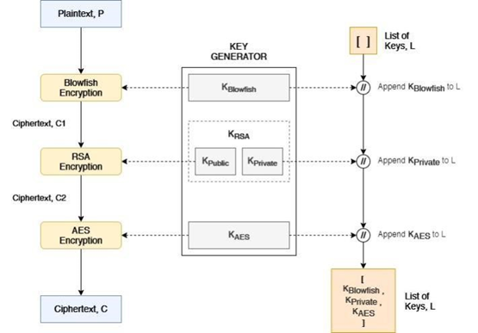
Proposed Method

Slide 10
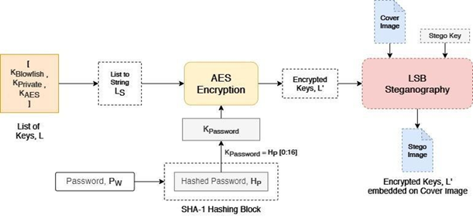
Proposed Method

Slide 11
Experiment Environment
The experiment environment for the project includes a machine with the following specifications:
Processor:
Intel Core i5
Memory (RAM):
32GB RAM
Storage:
1 TB HDD
Operating System:
Windows OS
Experiment IDE:
Google Colab
Programming Language:
Python
Department of Computer Science and Engineering

Slide 12
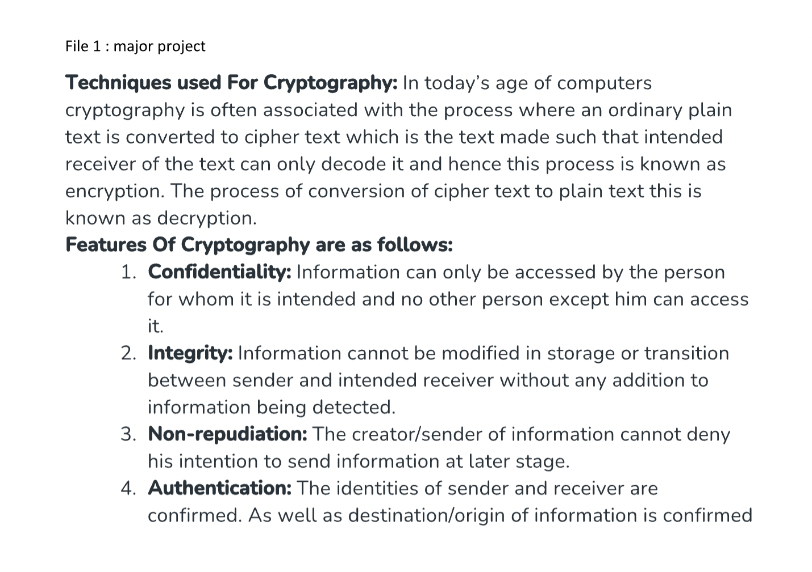
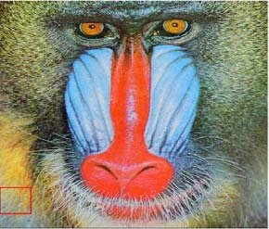

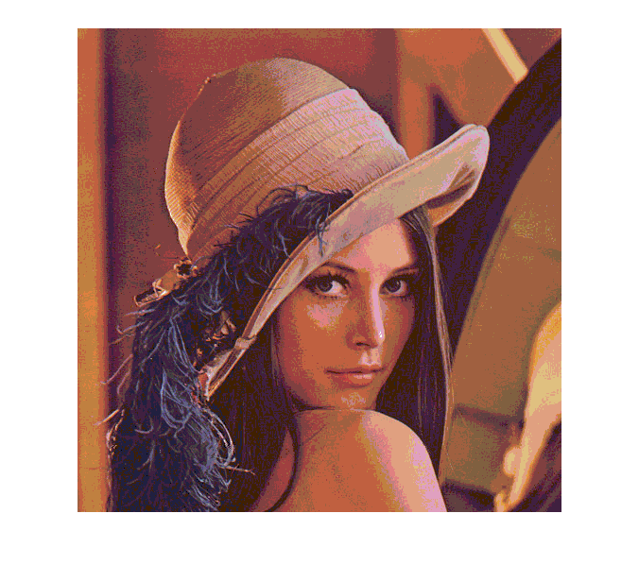
Experiment Screenshots
Input : mpfile.docx and images for steganography

Slide 13
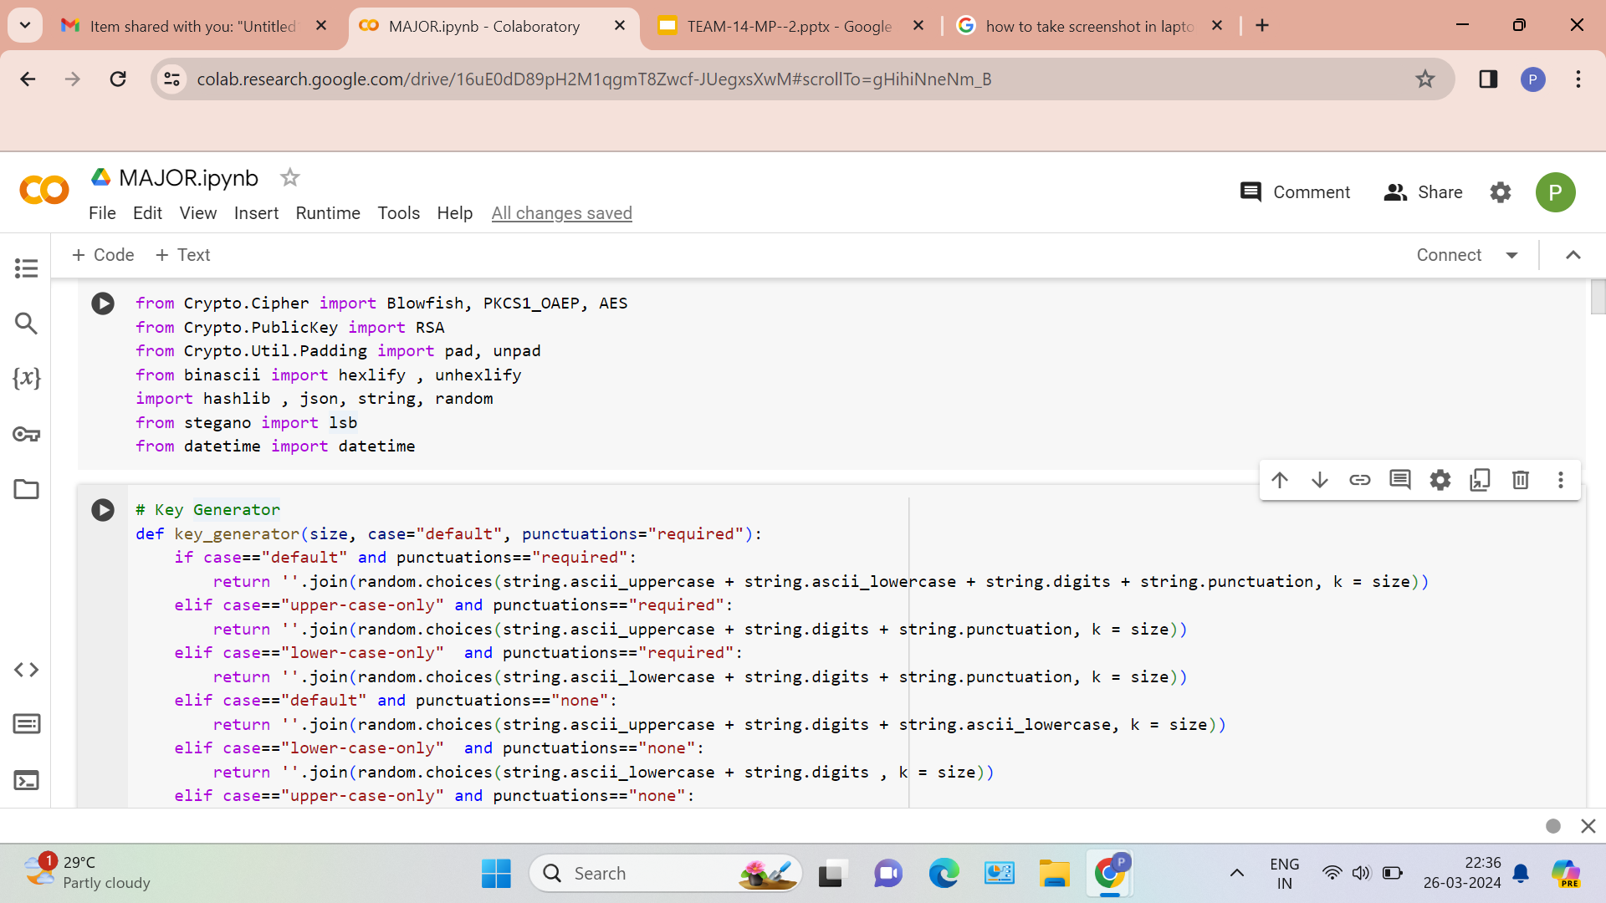
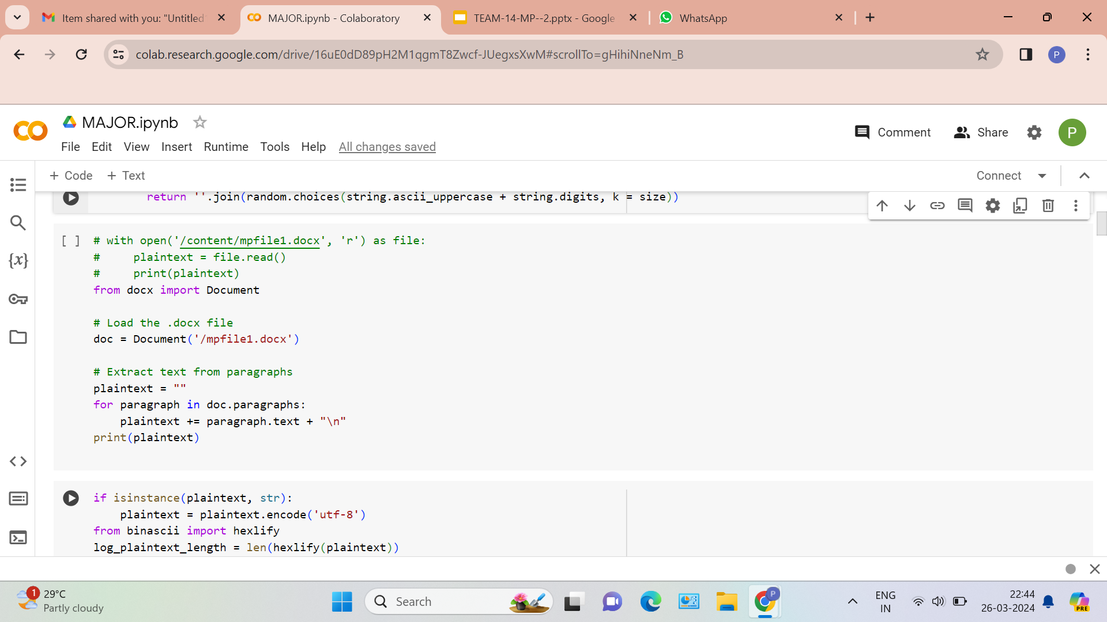
Experiment Screen shorts
Department of Computer Science and Engineering

Slide 14
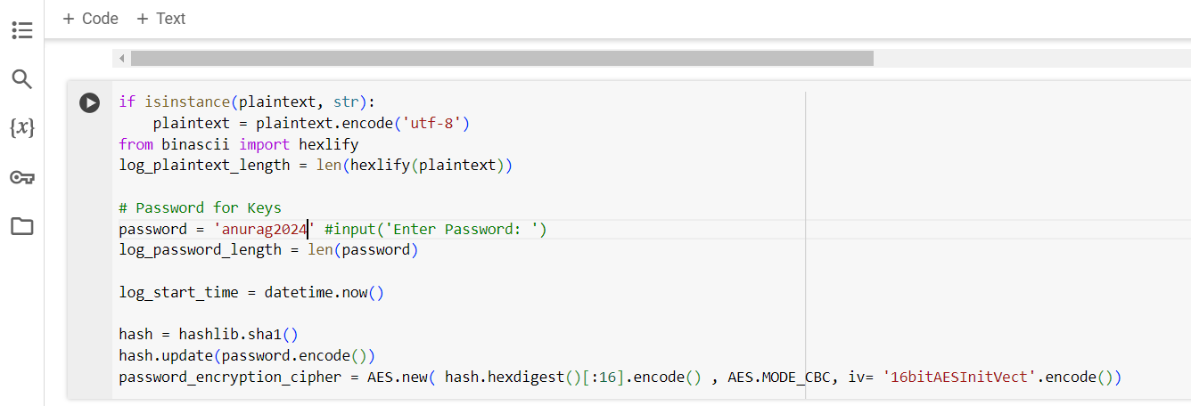
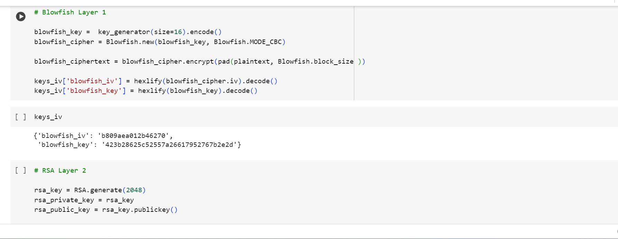
Experiment Screenshots
Department of Computer Science and Engineering

Slide 15
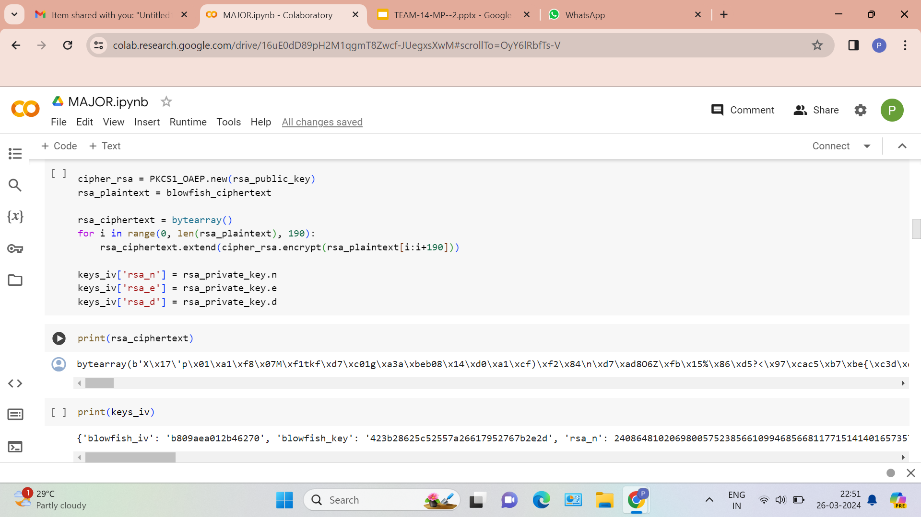
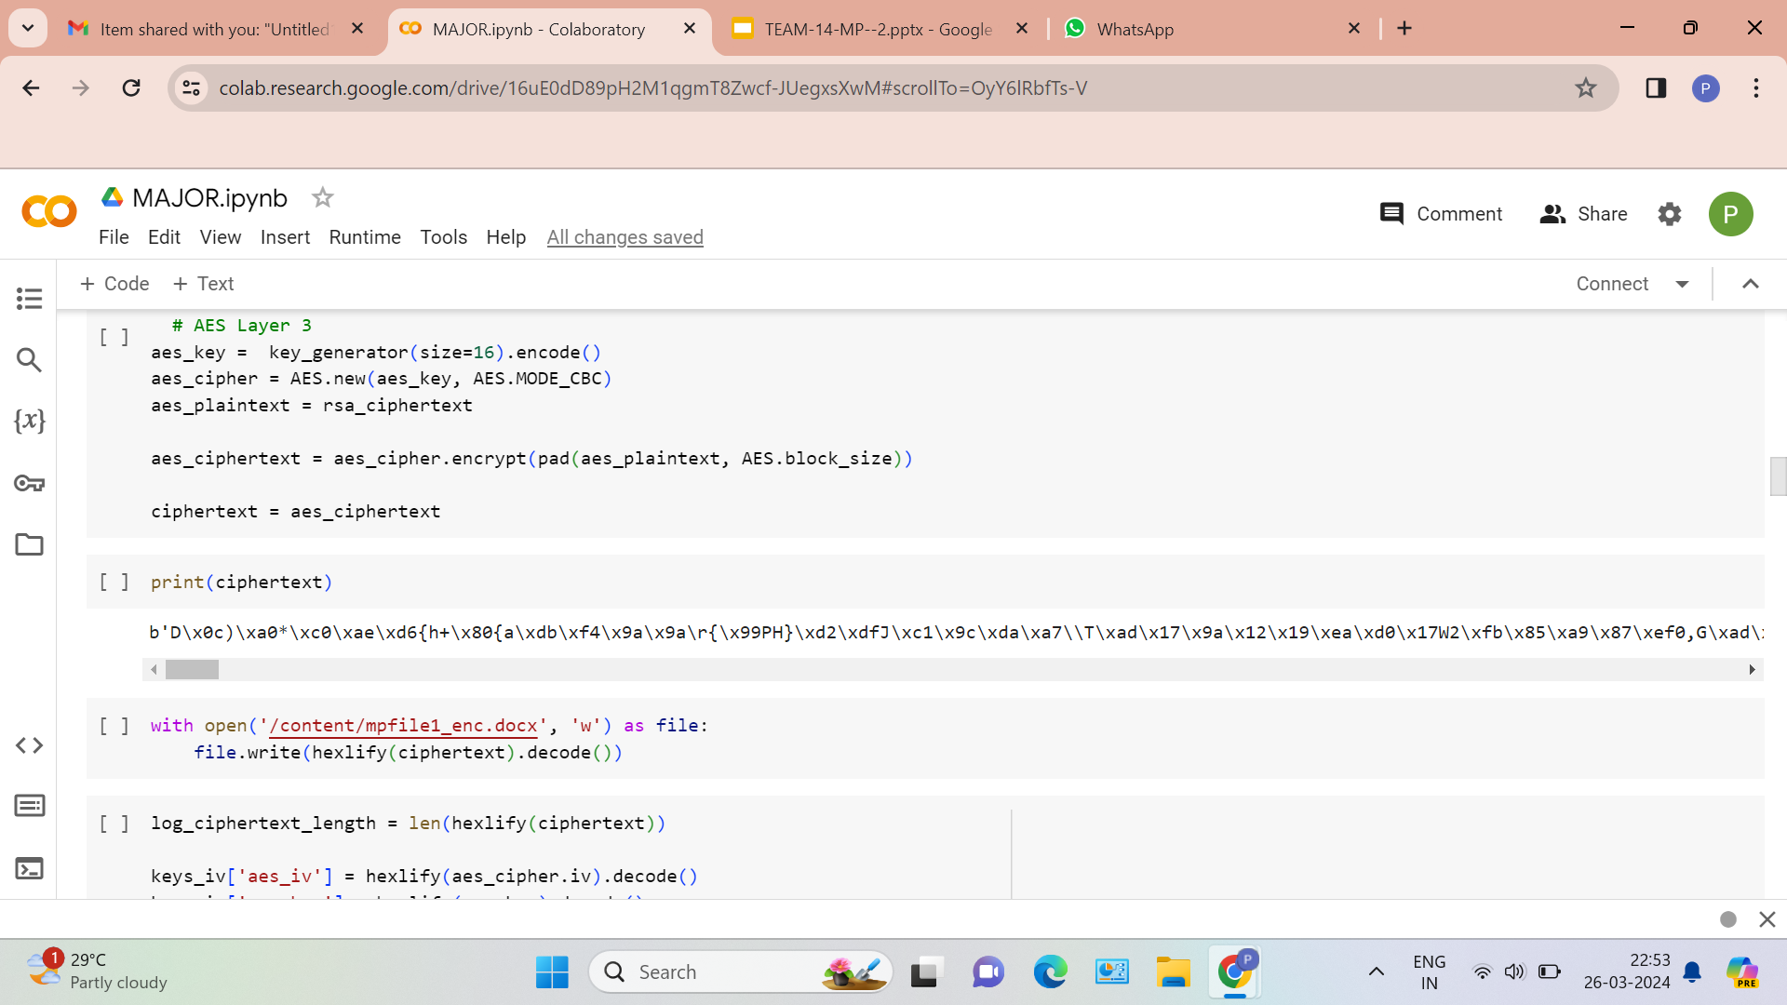
Experiment Screenshots
Department of Computer Science and Engineering

Slide 16
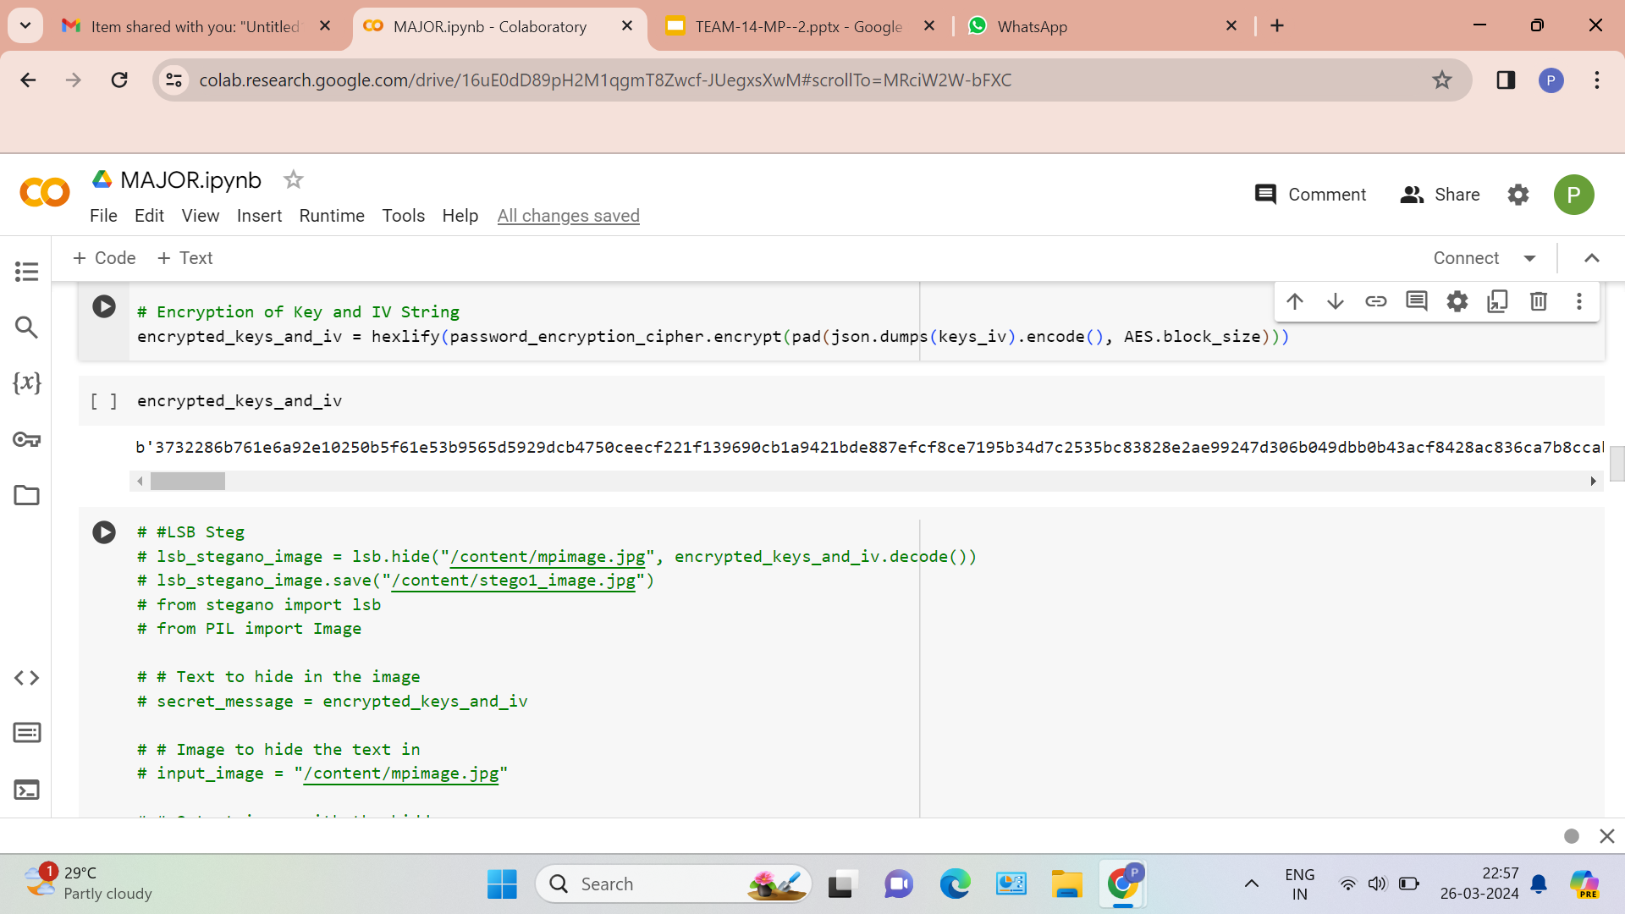
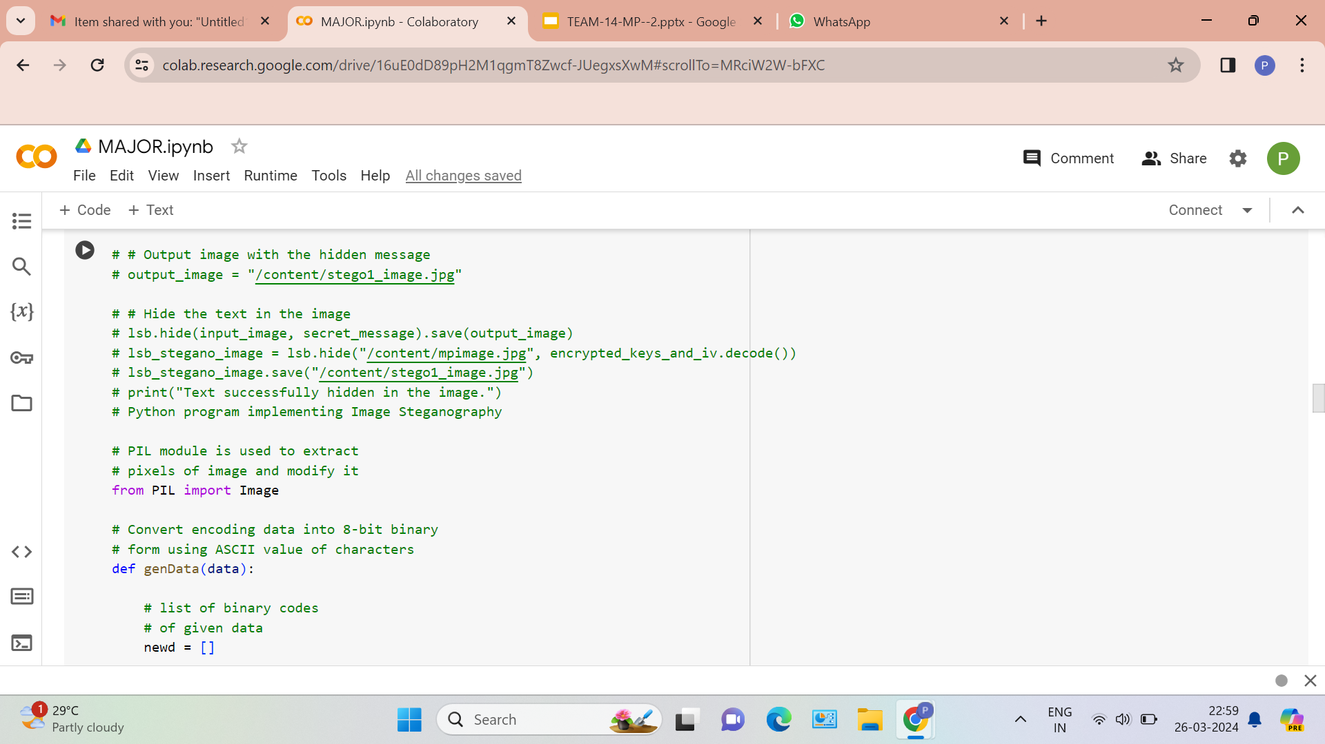
Experiment Screenshots
Department of Computer Science and Engineering

Slide 17
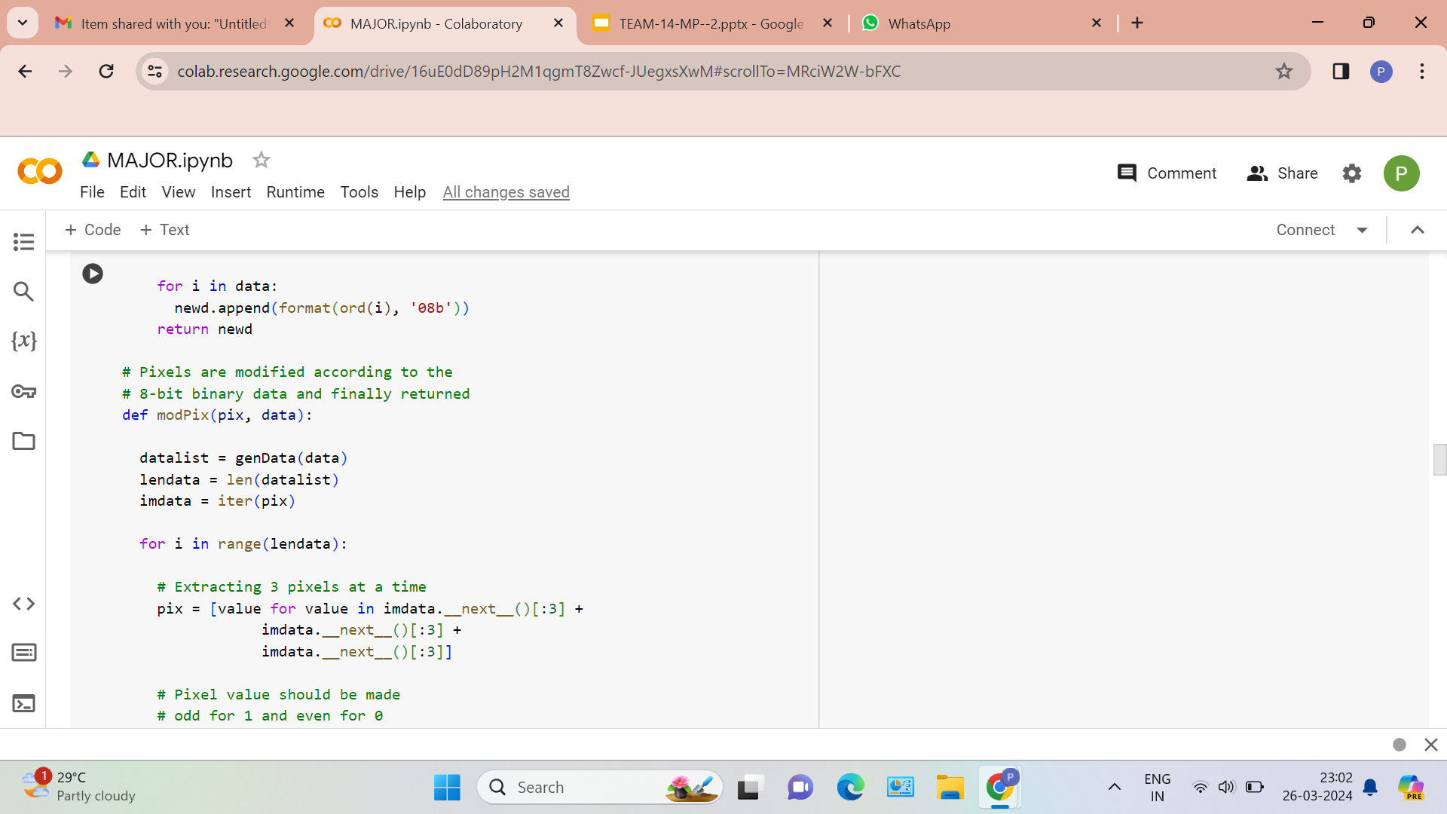
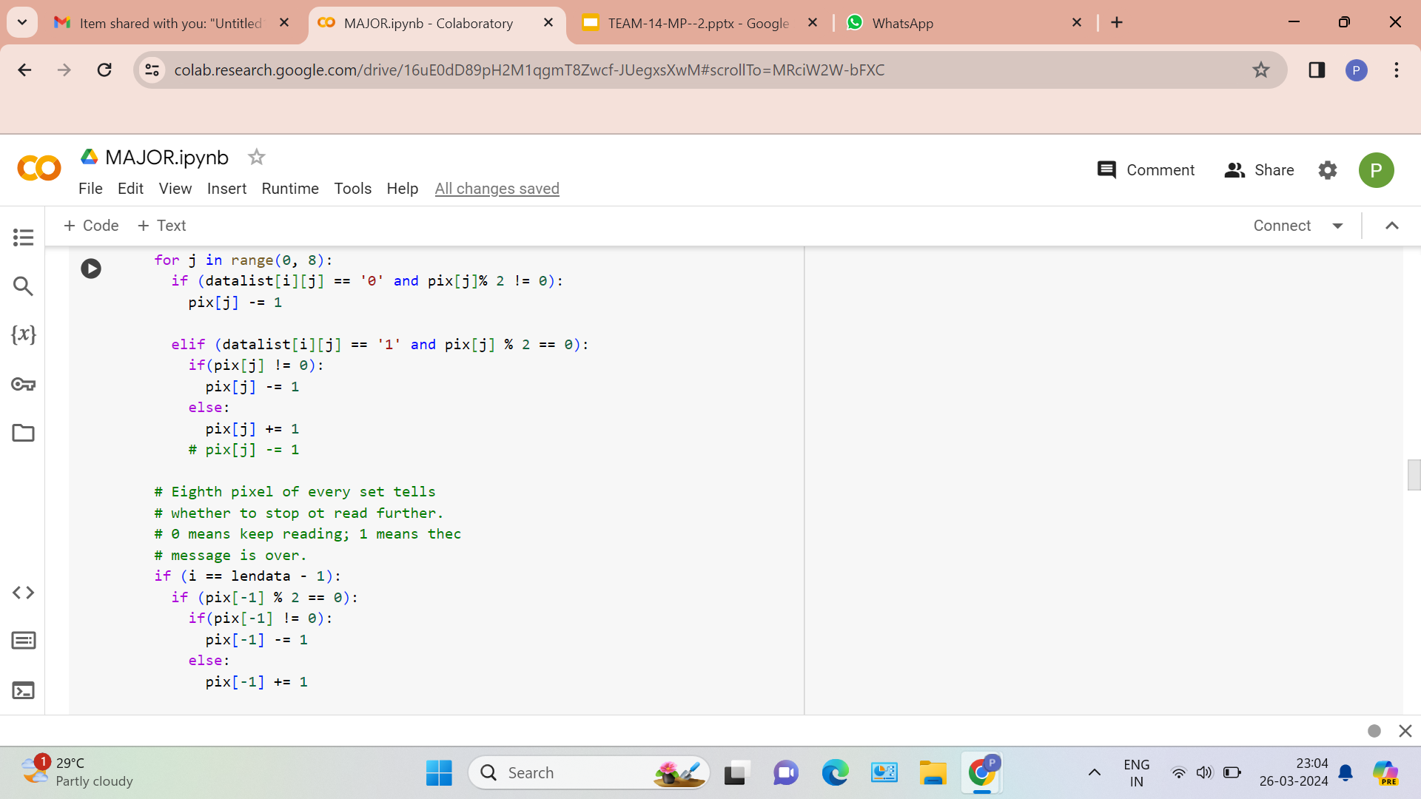
Experiment Screenshots

Slide 18
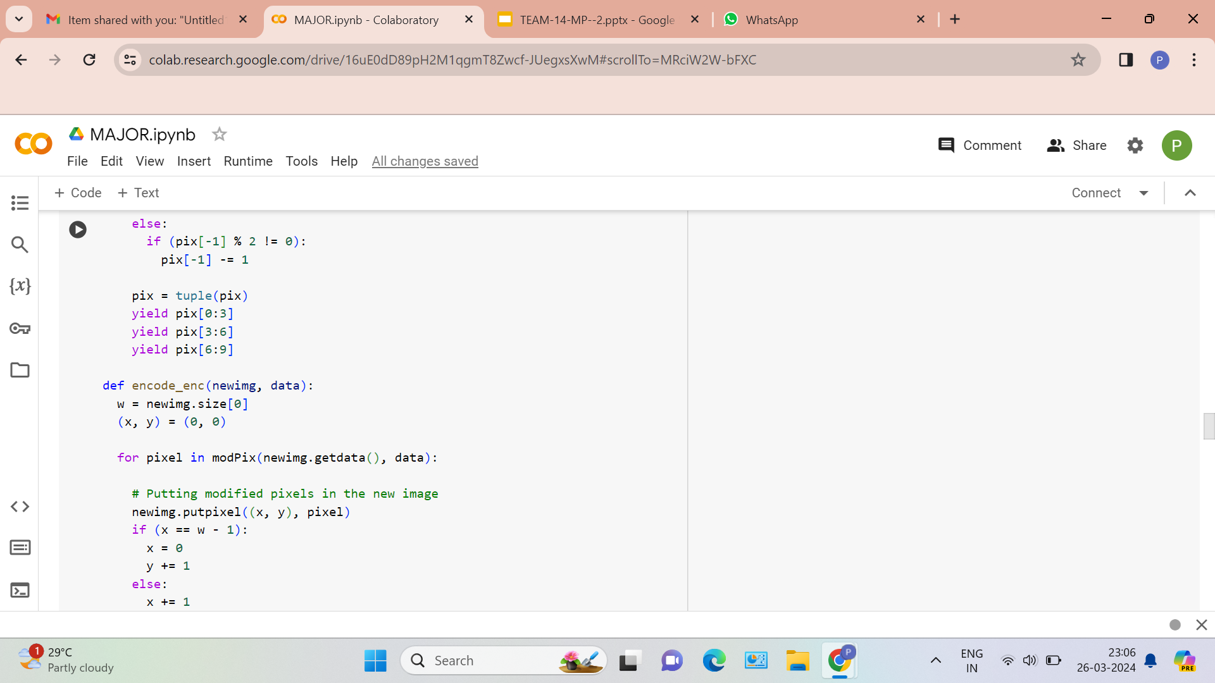
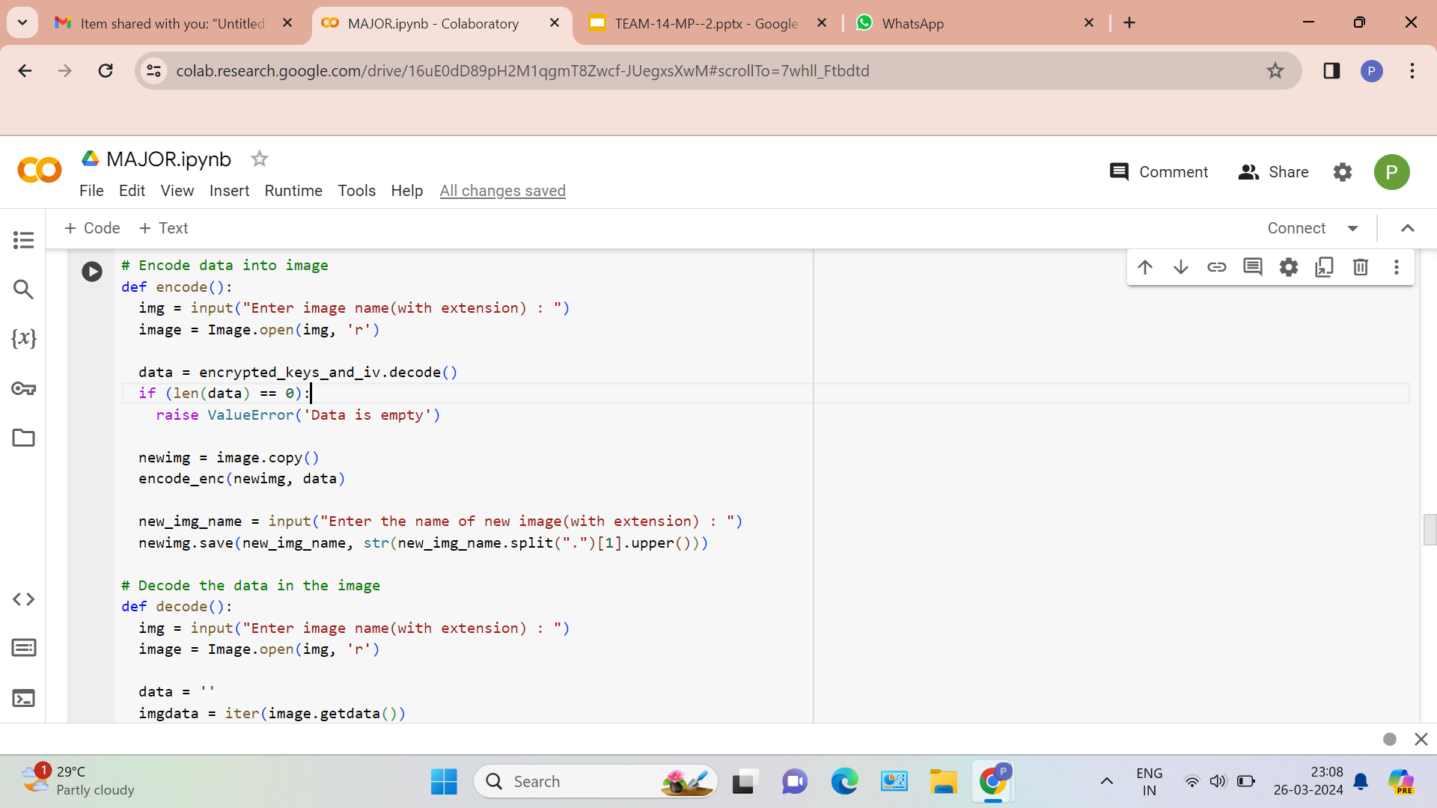
Experiment Screenshots

Slide 19
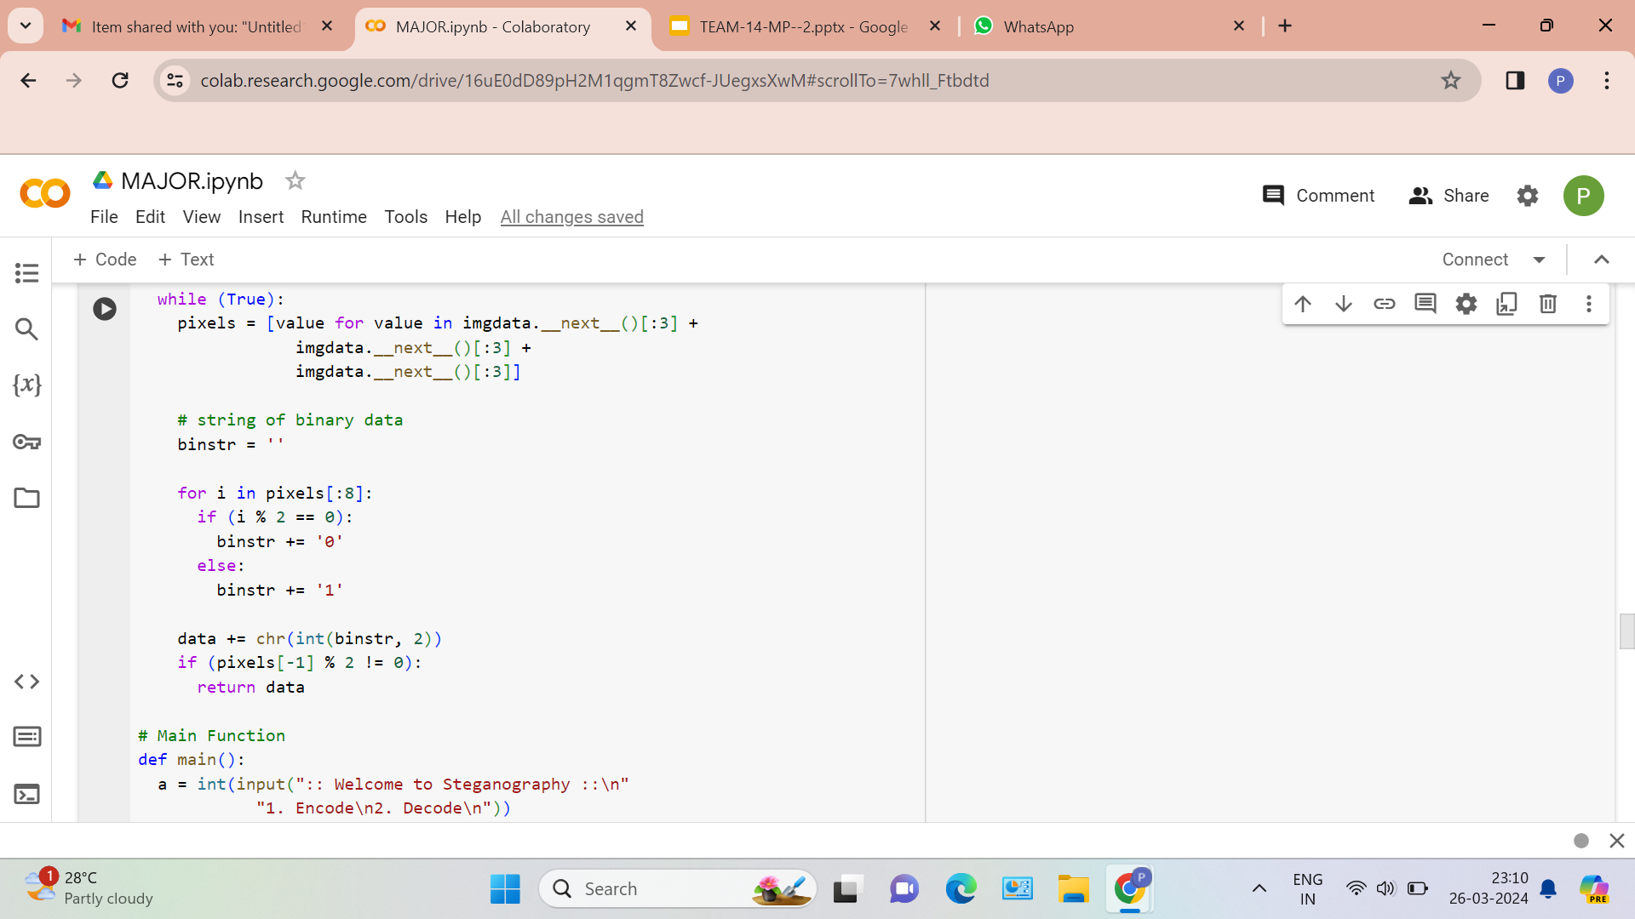
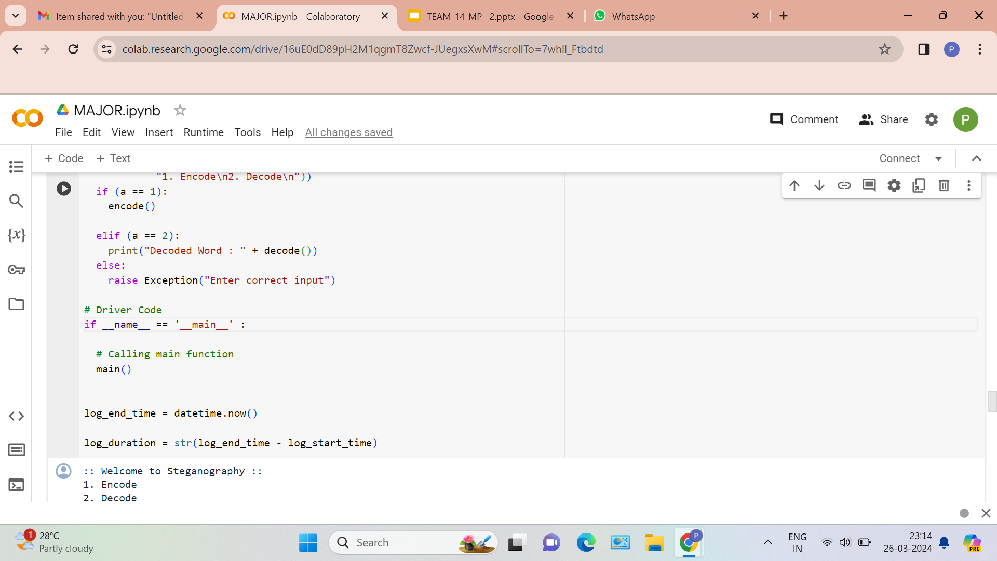
Experiment Screenshots

Slide 20
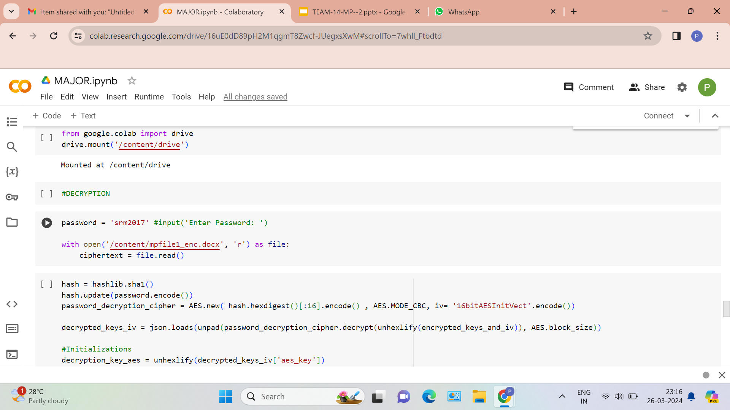
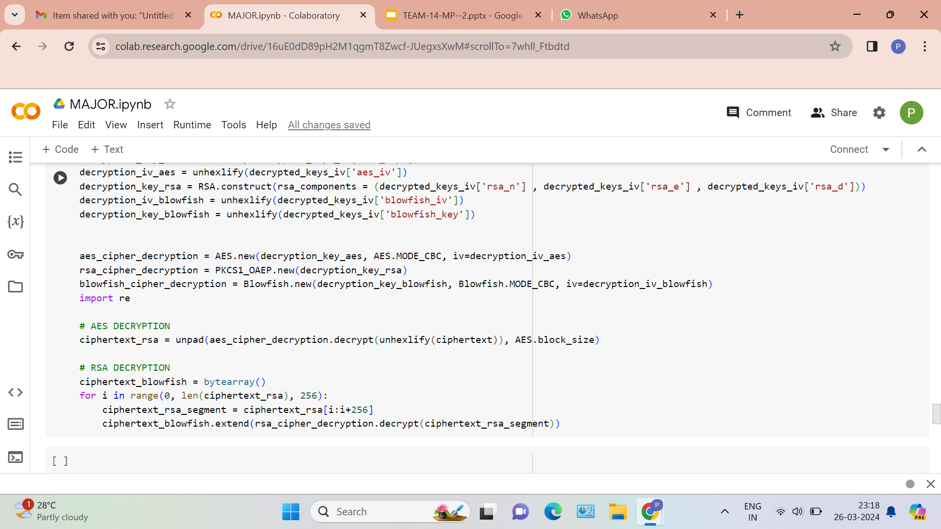
Experiment Screenshots

Slide 21
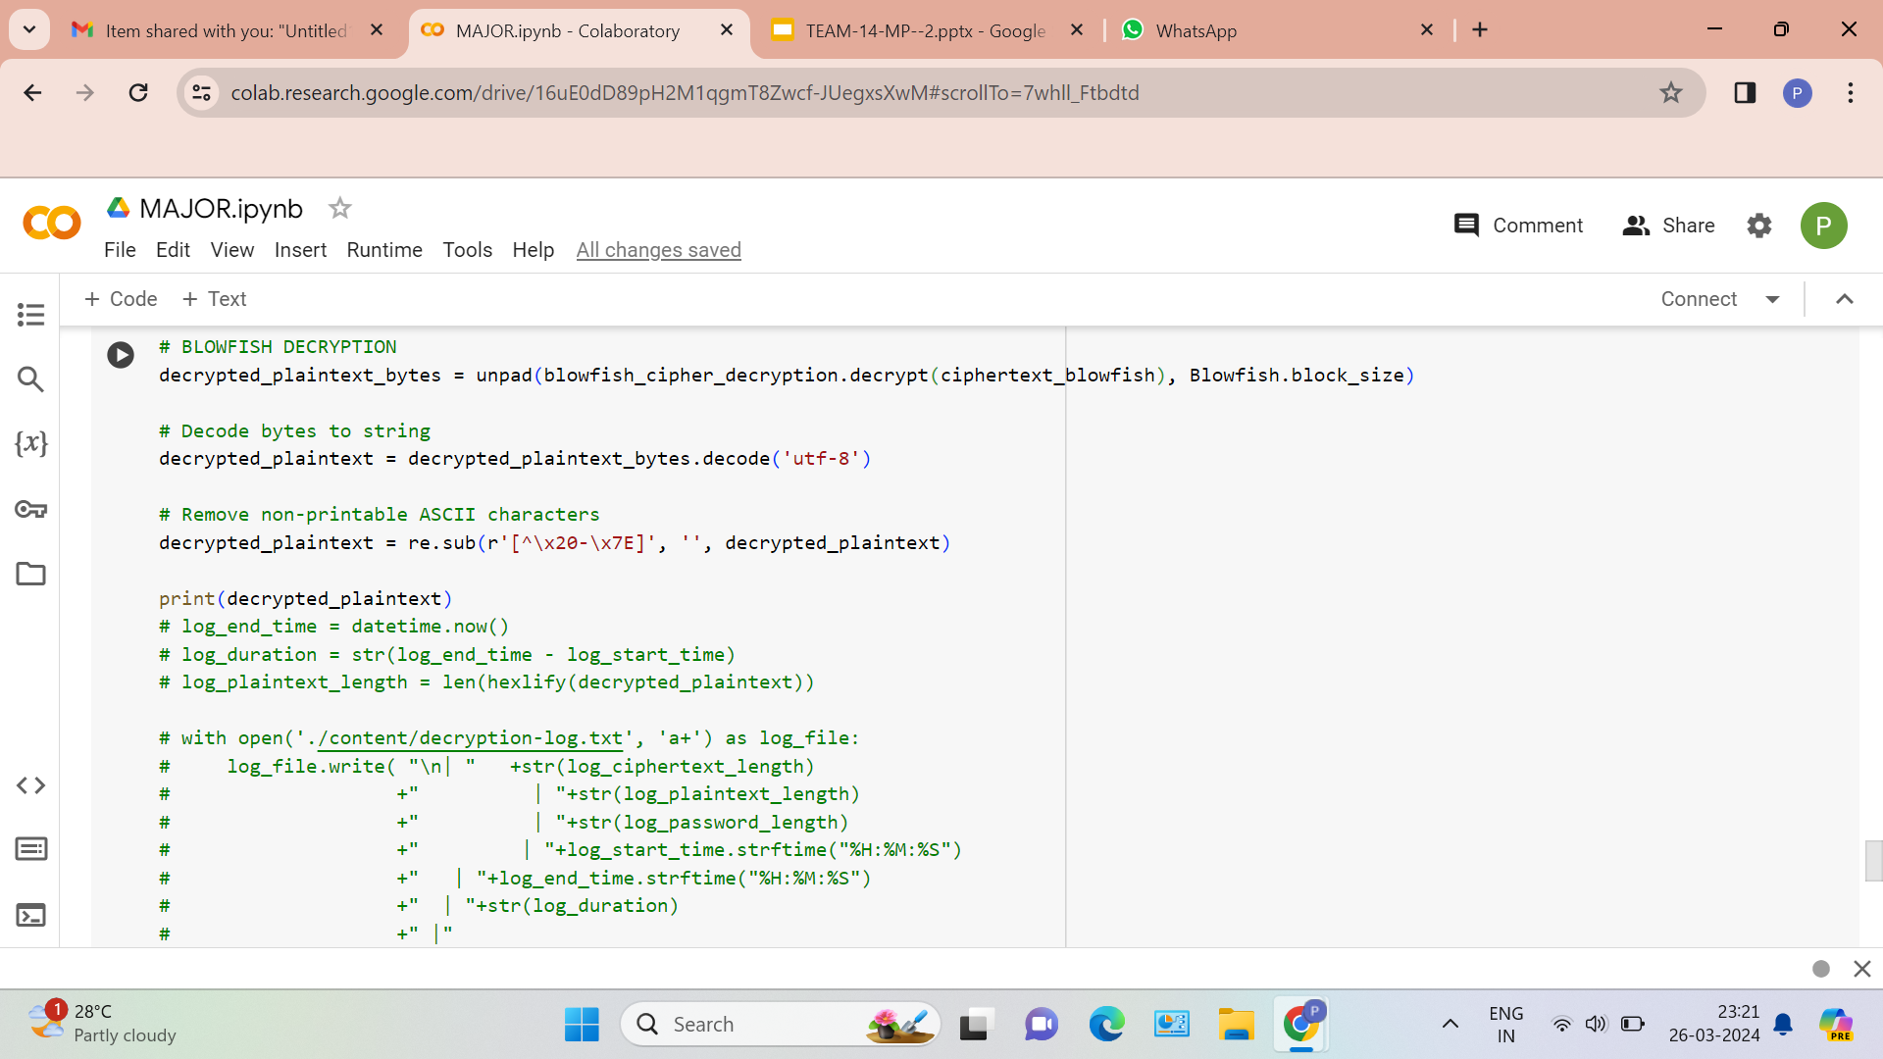
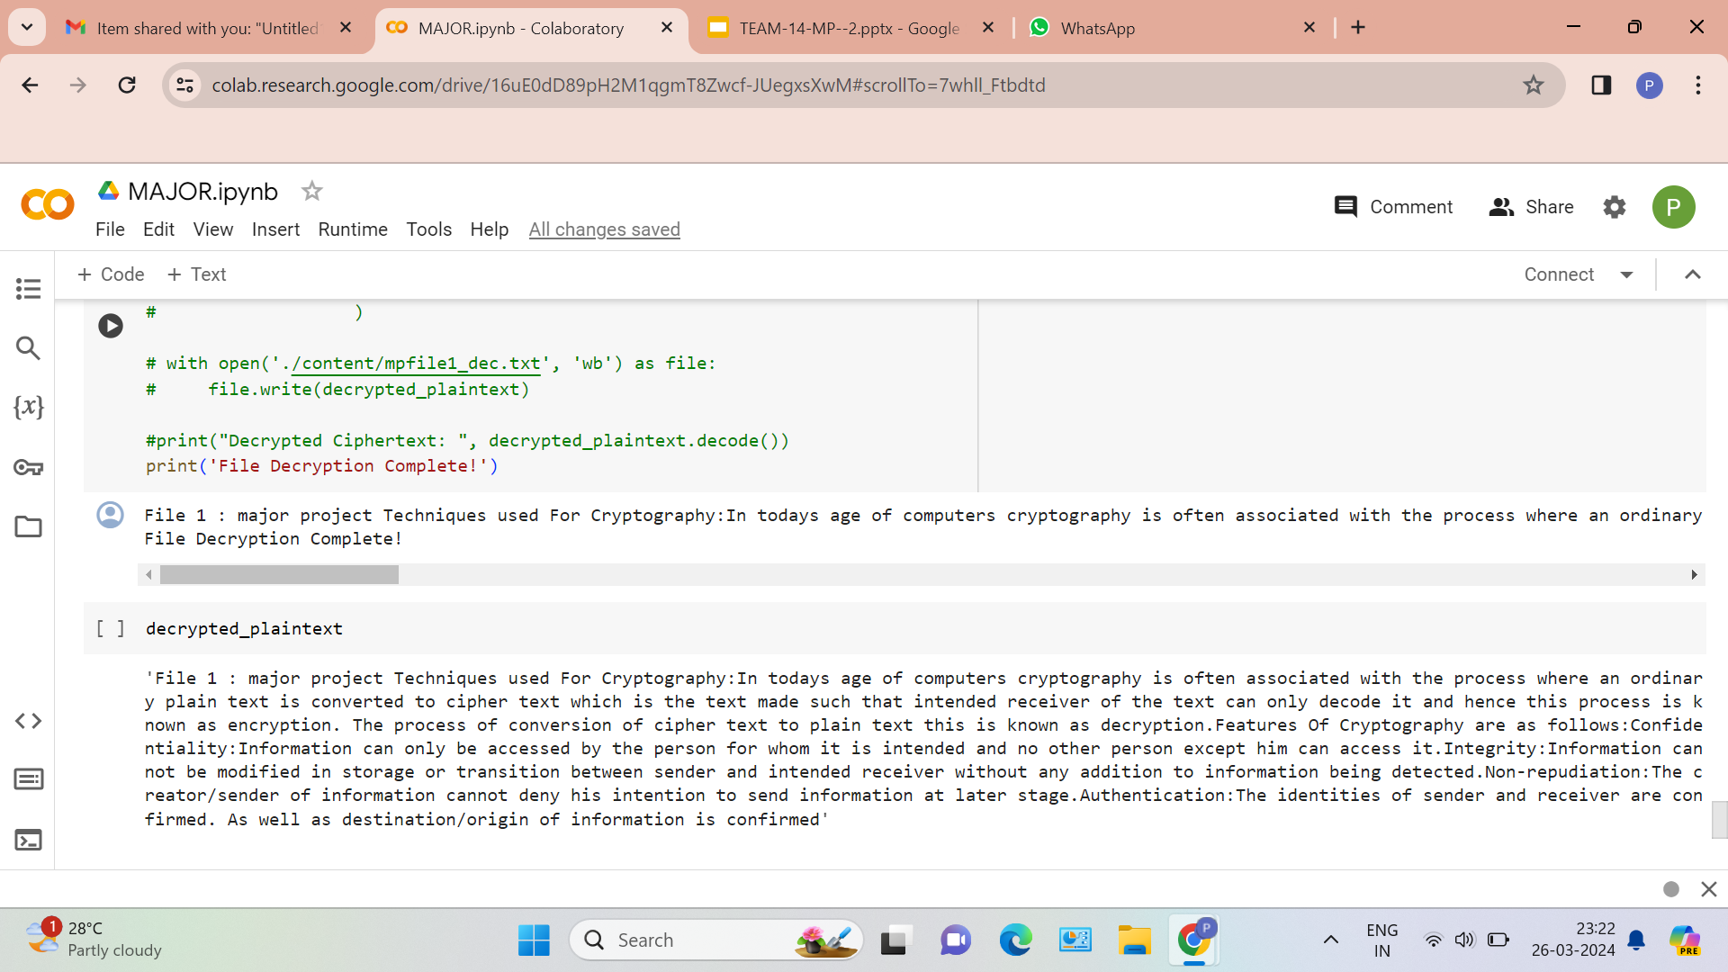
Experiment Screenshots

Slide 22
Experiment Results
Image name | Parameter values | Method-1 | Method-2 | Method-3 | Method-4 | Proposed method
Baboon | PSNR | 86.78 | 48.34 | 42.86 | 61.94 | 60.292
 | MSE | 0.012 | 0.952 | 0.992 | 0.071 | 0.061
Lena | PSNR | 79.45 | 48.41 | 44.61 | 62.32 | 64.72
 | MSE | 0.021 | 0.938 | 0.999 | 0.038 | 0.02
Bell Pepper | PSNR | 85.89 | 48.31 | 44.68 | 63.19 | 55.51
 | MSE | 0.112 | 0.956 | 0.9986 | 0.031 | 0.018

Slide 23
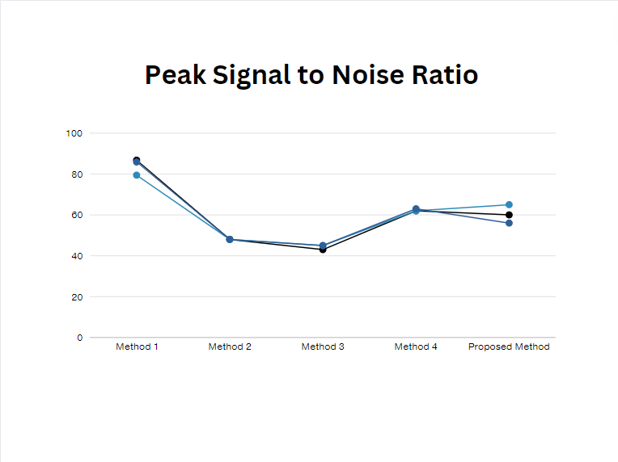
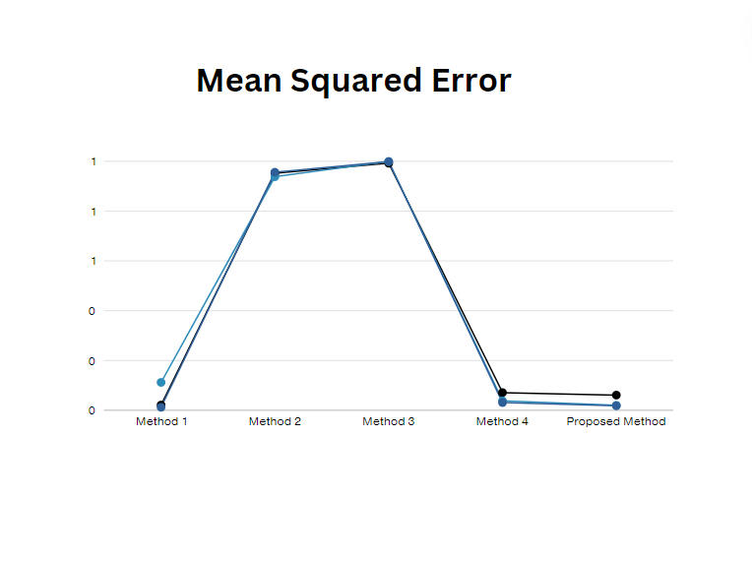
Experiment Results

Slide 24
Experiment Results
The Proposed Method consistently outperforms the other methods across all images, achieving the highest PSNR values and the lowest MSE values(closer to zero) . This indicates that the Proposed Method provides better reconstruction quality and fidelity compared to Method-1, Method-2, Method-3, and Method-4.(Here Method-1 is LSB steganography, Method-2 is modified LSB substitution, Method-3 is adjacent pixel value differencing and LSB substitution technique, Method-4 is Inverted LSB image steganography using an adaptive pattern to improve imperceptibility) .
The higher PSNR values imply that the Proposed Method preserves more signal information and produces less distortion compared to the other methods. Similarly, the lower MSE values indicate that the Proposed Method results in smaller errors between the original and reconstructed images.
Therefore, based on the provided data, the Proposed Method can be considered the best-performing approach for image reconstruction among the compared methods.

Slide 25
Finding
The project's proposed method integrates a threefold encryption system with key storage and LSB steganography, aiming to fortify data transmission security comprehensively. By utilizing Blowfish, RSA, and AES encryption algorithms, the system ensures robust protection against various cyber threats. Unlike some existing methods that focus solely on steganography or encryption, the proposed approach combines both techniques, resulting in a more comprehensive security framework. This ensures that data remains secure not only during transmission but also when stored and accessed. While existing steganographic methods focus on minimizing detection risk and improving imperceptibility, the project's integration of LSB steganography with encrypted key embedding offers enhanced security. By concealing encrypted key strings within cover images, the system ensures data confidentiality while maintaining a low risk of detection.
Department of Computer Science and Engineering

Slide 26
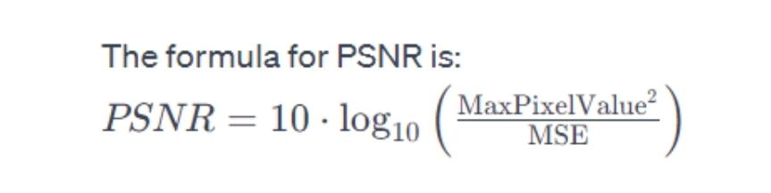
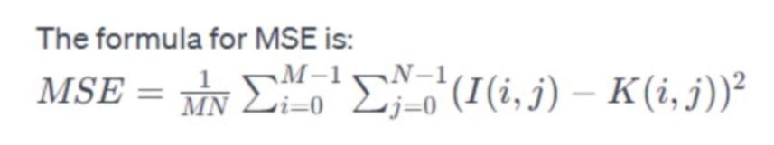
Justification
Parameters Improved by the Proposed Method:
Image Quality: The proposed method aims to enhance image quality by minimizing distortion introduced during encryption and decryption processes.
Security: The method focuses on improving security by employing multiple encryption layers and steganography techniques to protect the image data from unauthorized access.
Parameter Formulas:
Improved parameter values result from:
Enhanced encryption with multiple layers (Blowfish, RSA, AES) reduces data corruption risk.
LSB steganography conceals data within images, bolstering security without compromising quality.
Secure key management, including encryption and storage, mitigates key compromise risks.
A comprehensive approach addressing encryption and steganography ensures heightened image security, reflected in improved PSNR and MSE values.
Department of Computer Science and Engineering

